Slide 1

7th Grade Math
Unit 13, Lesson 3 Determining Appropriate Measures of Center and Variation Volume 2, pg. 245

Slide 2


Benchmark
MA.7.DP.1.1
Determine an appropriate measure of center or measure of variation to summarize numerical data, represented numerically or graphically, while taking into consideration the context and any outliers.
volume 2, pg. 245

Slide 3
Integrated Mathematical Thinking and Reasoning Standards
MA.K12.MTR.2.1 Demonstrate understanding by representing problems in multiple ways.
MA.K12.MTR.7.1 Apply mathematics to real-world contexts.
volume 2, pg. 245

Slide 4

Learning Target
I can determine an appropriate measure of center and variation to summarize numerical data.
volume 2, pg. 245

Slide 5

Warm-Up
volume 2, pg. 246

Slide 6
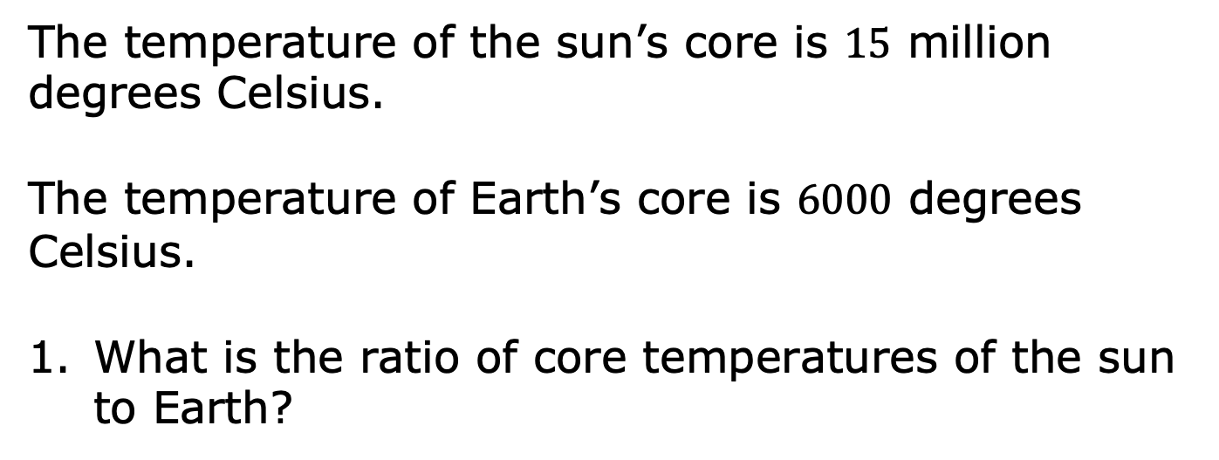
13.3.1 Warm-Up: Between Two Numbers
volume 2, pg. 246

Slide 7

Guided Practice
volume 2, pg. 246

Slide 8

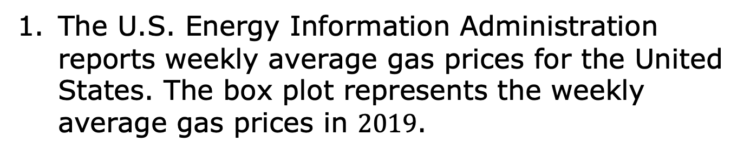
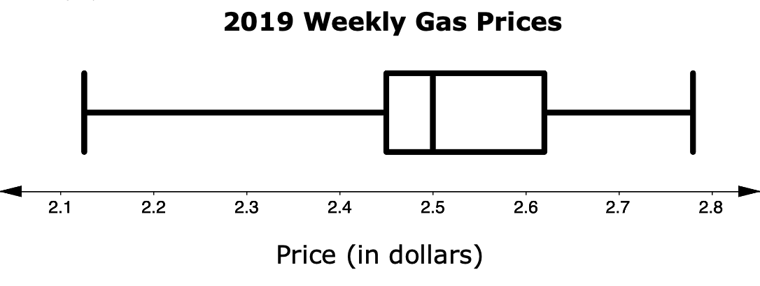
13.3.2 Guided Practice: Measures of Center and Variation
volume 2, pg. 246

Slide 9
Explain which measure of center, the mean or the median, best describes the center of the data.
If possible, find the value of the measure you chose in Part A.
volume 2, pg. 246

Slide 10
Describe the variation of the weekly average price of gasoline.
Given your description, does the interquartile range or range better represent the variation in price?
volume 2, pg. 247

Slide 11
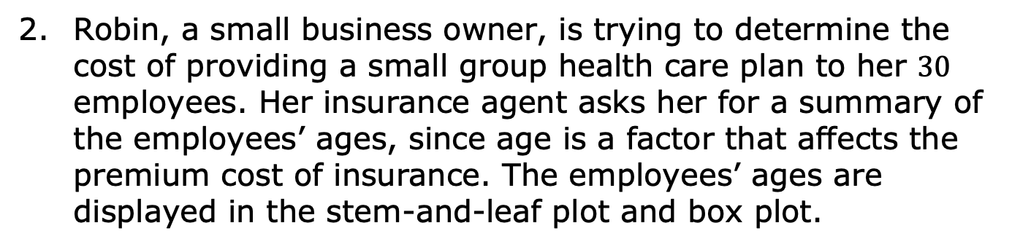
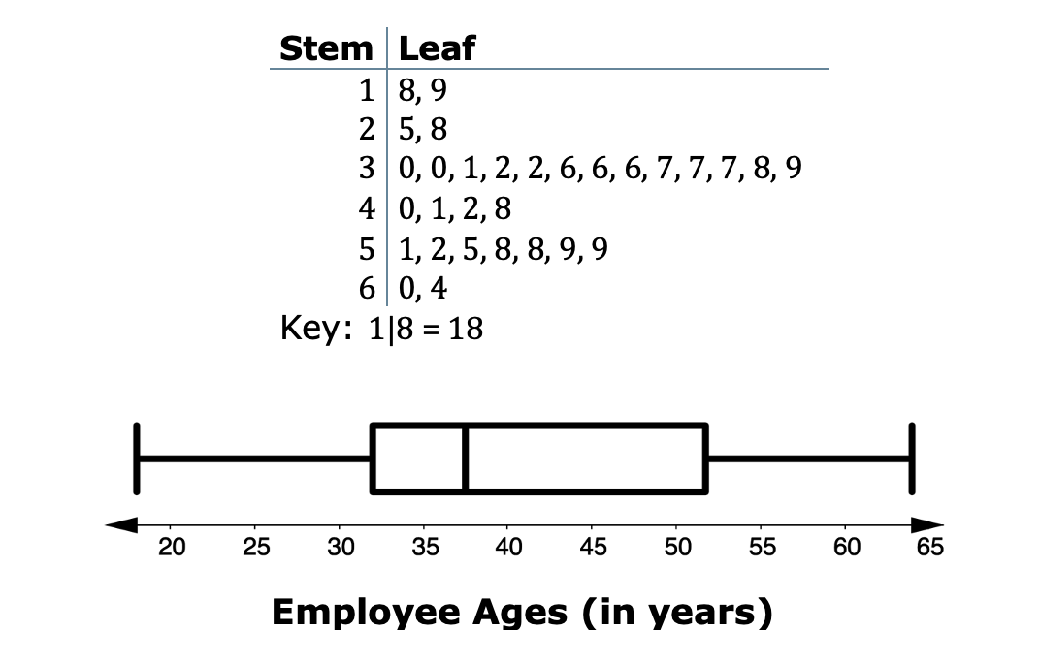
volume 2, pg. 247

Slide 12
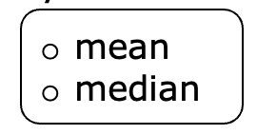
Complete the statements to explain which measure of center and variation Robin should provide to her insurance agent to accurately summarize the ages of her employees.
The best summarizes the center of the data for the agent because …
volume 2, pg. 247

Slide 13
The best summarizes the variation of the data for the agent because …
IQR
range
volume 2, pg. 248

Slide 14

Try It
volume 2, pg. 248

Slide 15

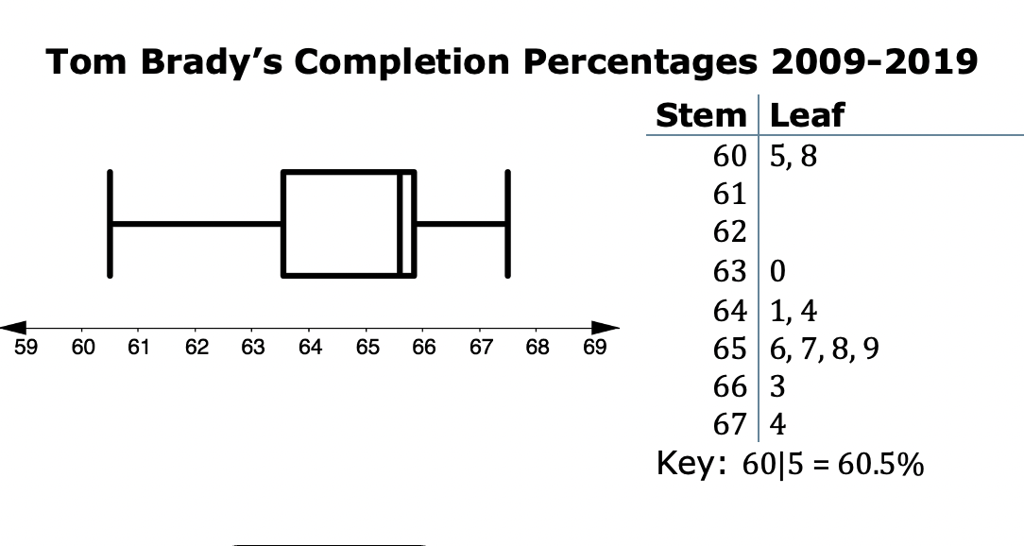
13.3.3 Try It: Measures of Center and Variation
Tom Brady is considered by most to be one of the best NFL quarterbacks of all time. His pass-completion percentages from 2009 to 2019 are shown in the box plot and stem-and-leaf plot.
volume 2, pg. 248

Slide 16
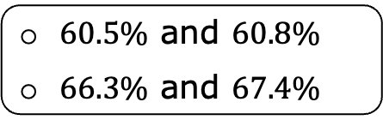
The best summarizes the center of the data. The is not the best measure of center because it is influenced by the values that are far from the rest of the data values.
mean
median
mean
median
volume 2, pg. 248

Slide 17
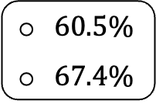
b. The best summarizes the variation of the data. The is not the best measure of variation because it is affected by the value from the rest of the data.
IQR
range
IQR
range
volume 2, pg. 248

Slide 18
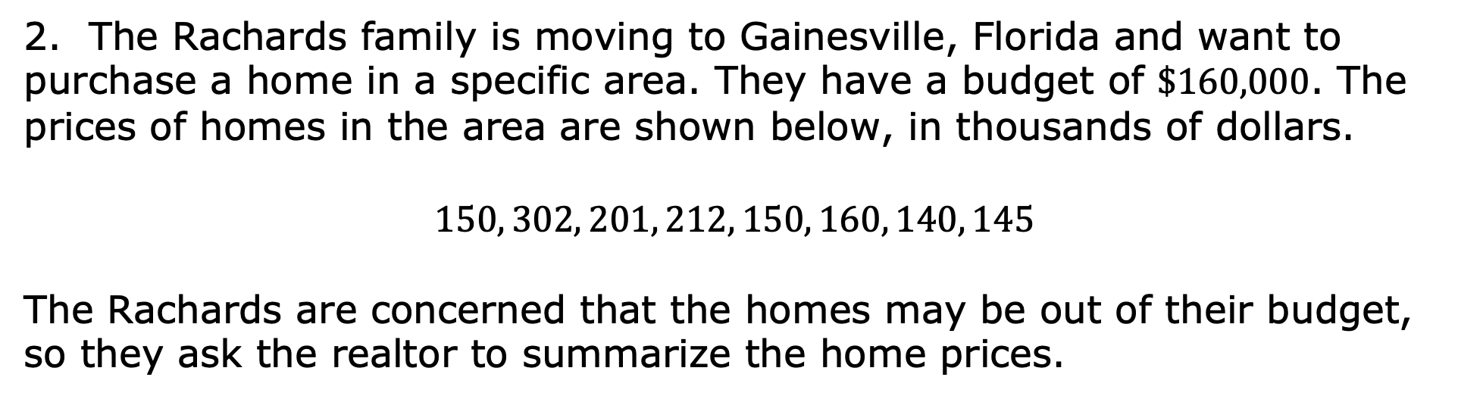
2. The Rachards family is moving to Gainesville, Florida and want to purchase a home in a specific area. They have a budget of $\$160,000$. The prices of homes in the area are shown below, in thousands of dollars.
$$150, 302, 201, 212, 150, 160, 140, 145$$
The Rachards are concerned that the homes may be out of their budget, so they ask the realtor to summarize the home prices.
volume 2, pg. 249

Slide 19
Which measure of center should the realtor report to the Rachards, the mean or the median? Explain your reasoning.
Which measure of variation should the realtor report to the Rachards, the interquartile range or the range? Explain your reasoning.
volume 2, pg. 249

Slide 20

Your Turn
volume 2, pg. 249

Slide 21
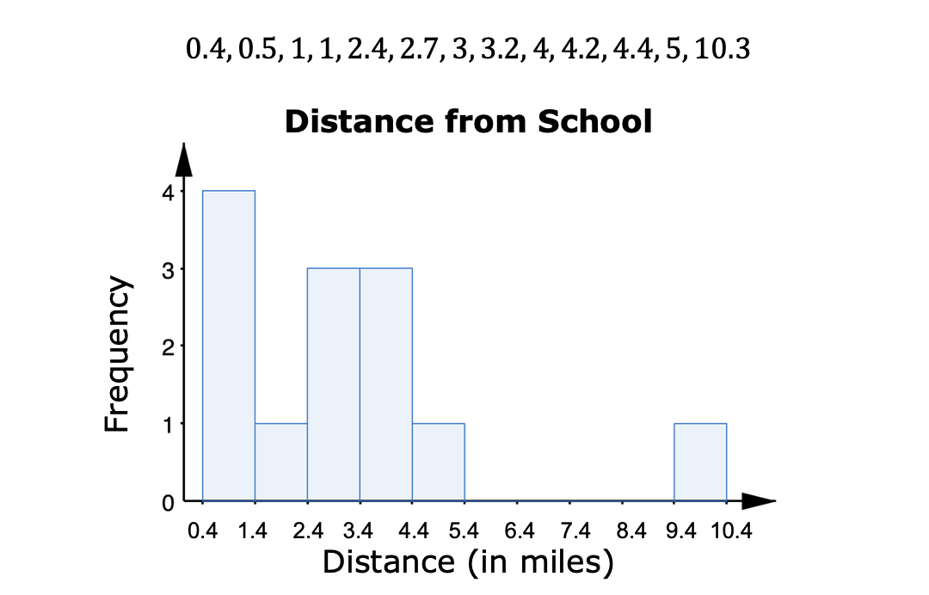
13.3.4 Your Turn!
Zane and $12$ of his friends listed how far, in miles, they live from the school and created a histogram.
volume 2, pg. 249

Slide 22
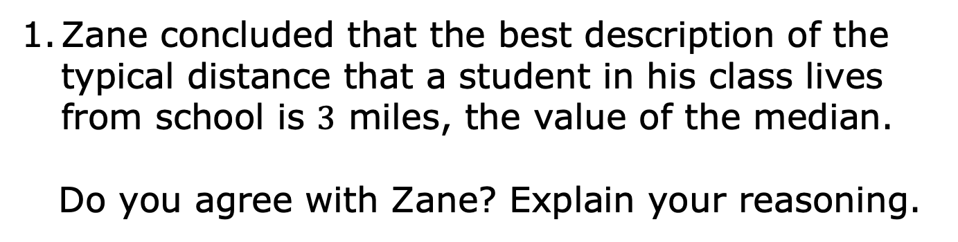
volume 2, pg. 249

Slide 23
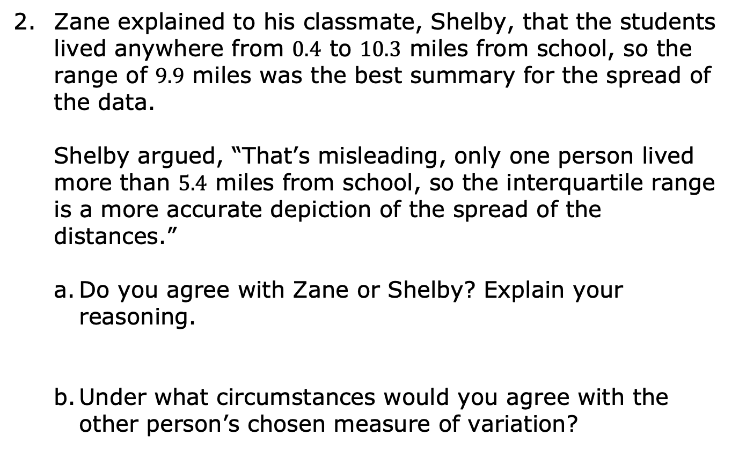
volume 2, pg. 250

Slide 24
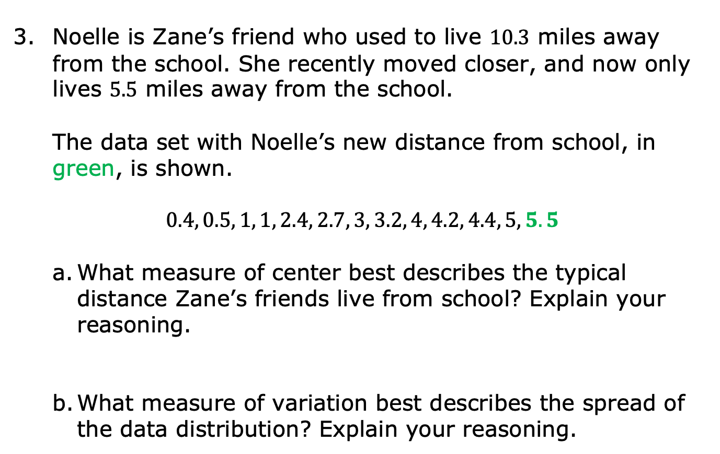
volume 2, pg. 250

Slide 25

Wrap-Up
volume 2, pg. 251

Slide 26
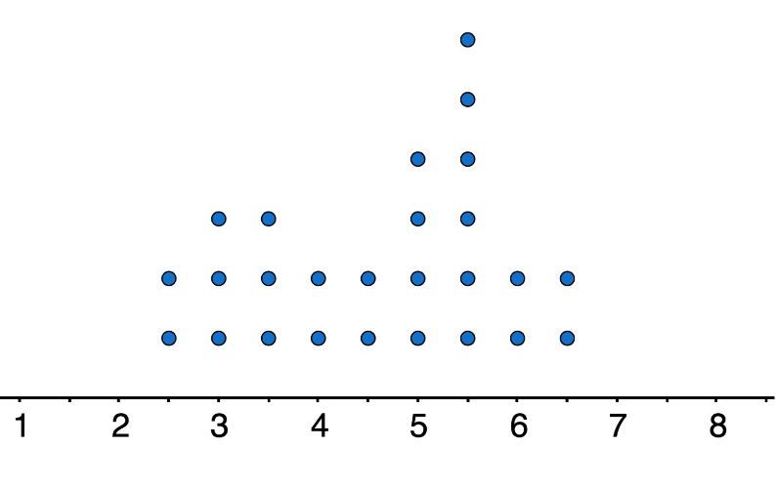
13.3.5 Wrap-Up: Ticket Out the Door
The dot plot summarizes the hours of battery life for students’ cell phones when streaming videos.
Battery Life (in hours)
volume 2, pg. 251

Slide 27
Mr. Funk’s world history class has an upcoming field trip to Tallahassee, Florida that involves a five-hour drive. The students want to be able to watch videos on their phones during the drive without charging their cell phones.
Determine the appropriate measure of center and variation for the battery life of the students’ cell phones when streaming videos.
volume 2, pg. 251

